Slide 1


Slide 2
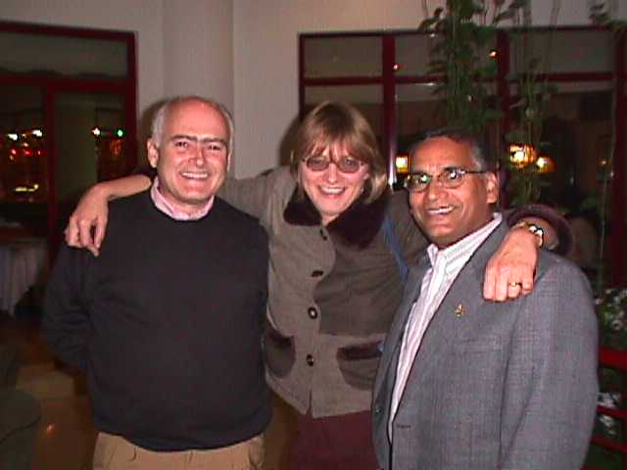

Slide 3


Slide 4


Slide 5
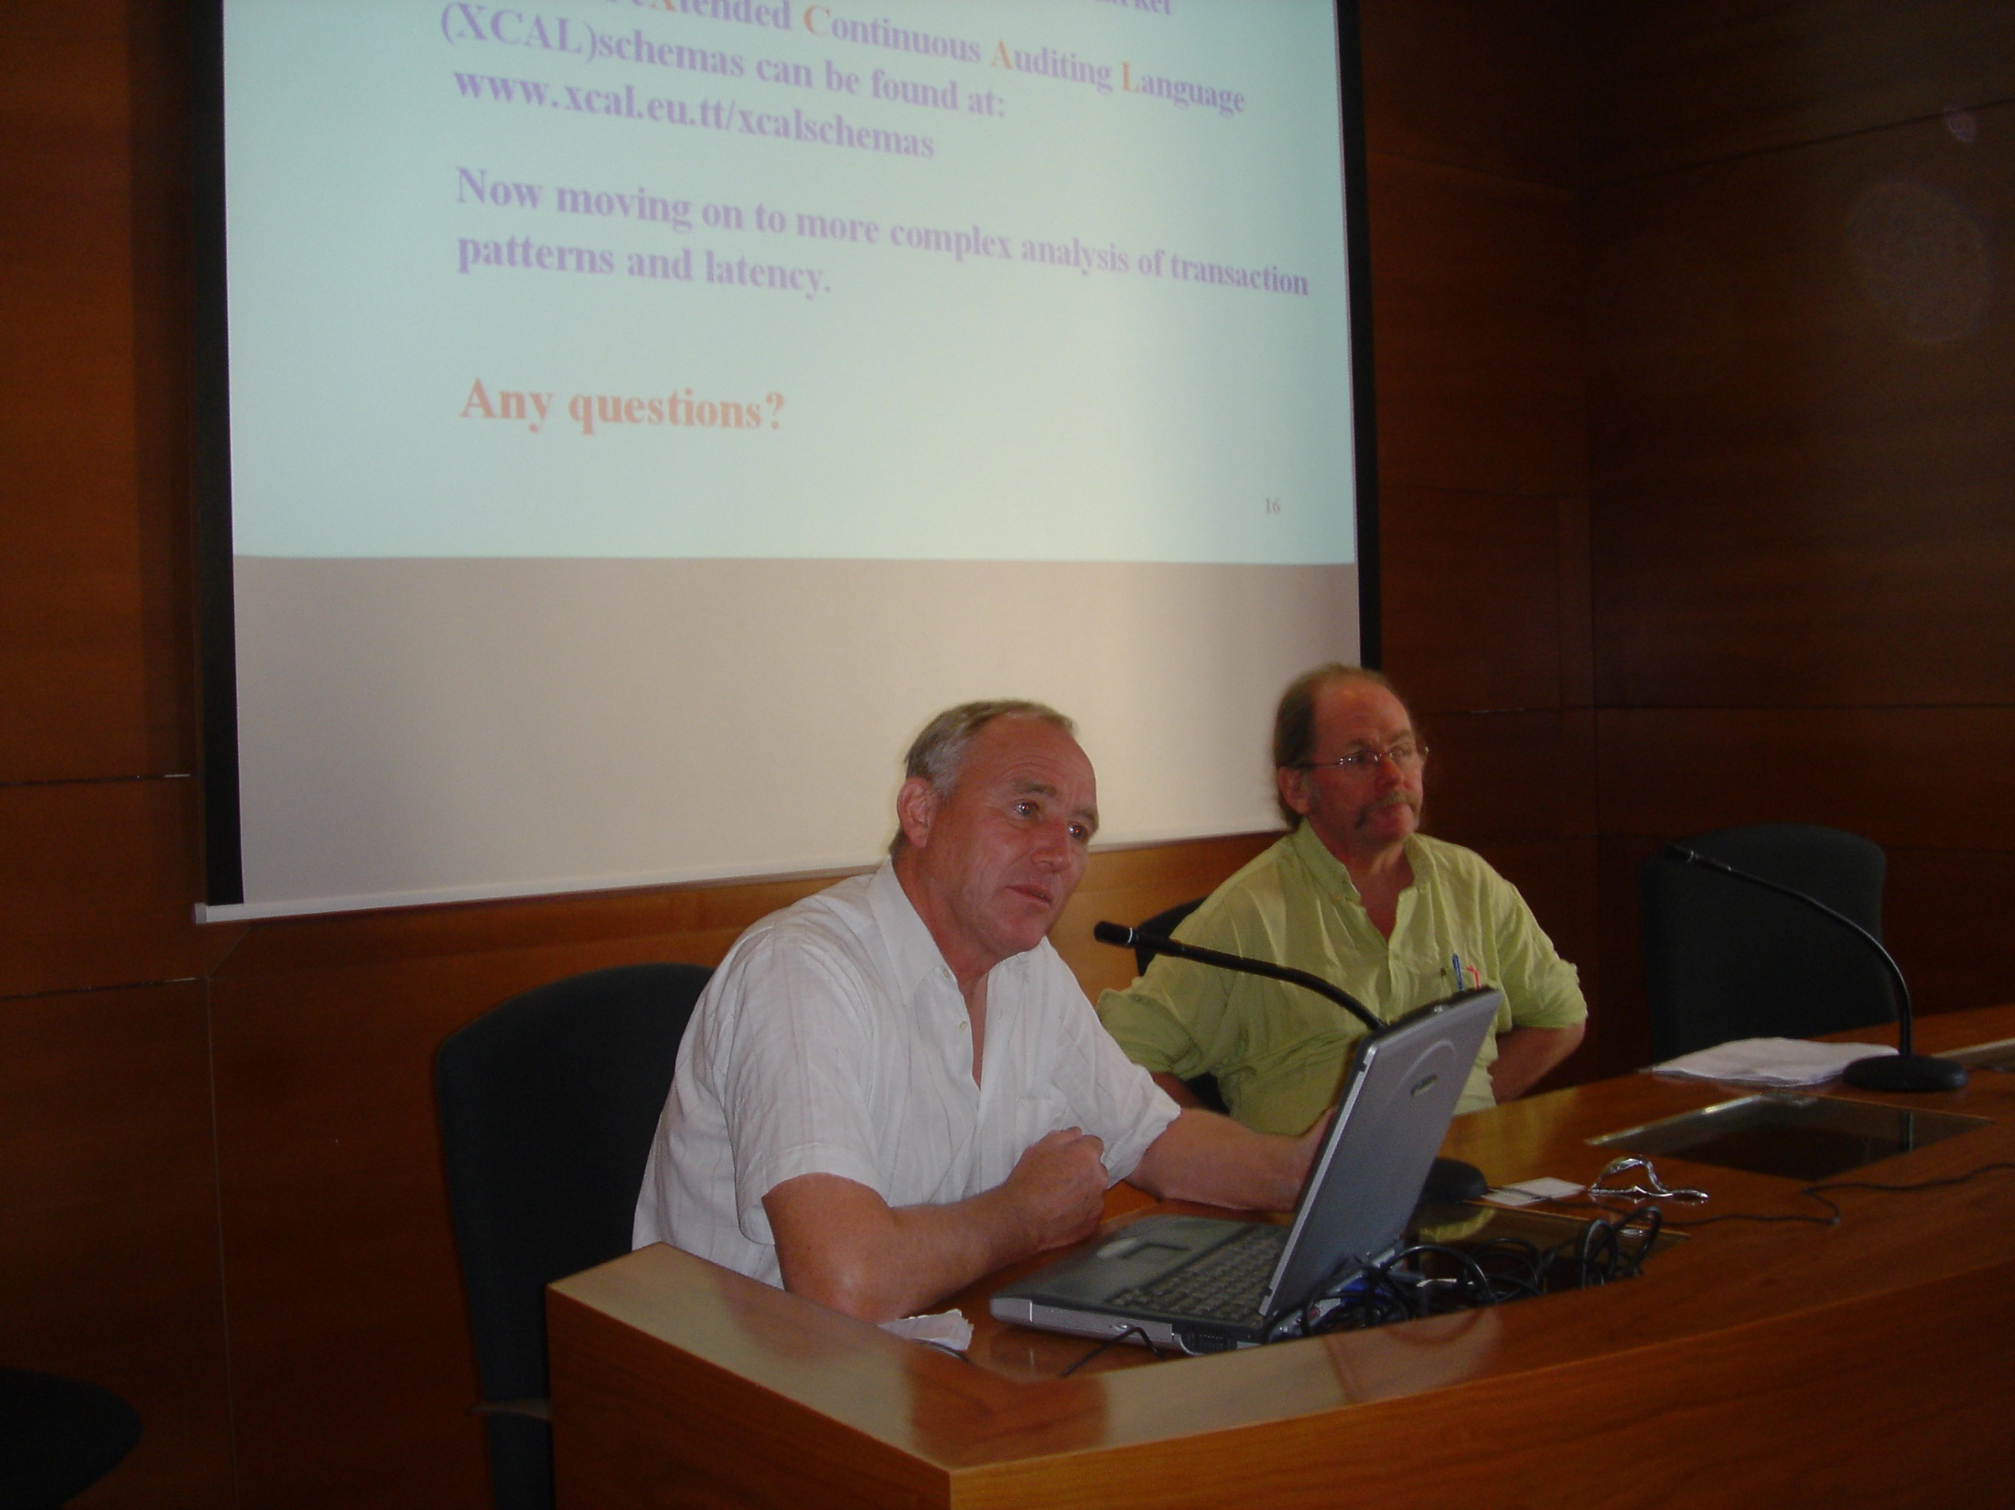

Slide 6
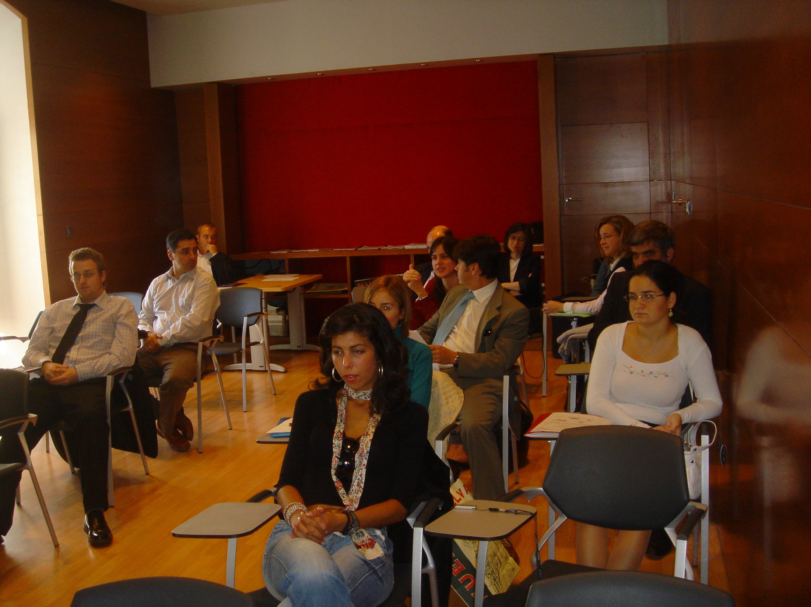

Slide 7
Artificial Intelligence In Auditing
Miklos A. Vasarhelyi
Kristyn Calabrese
March 21, 2019
Seville Spain

Slide 8
WORK ON AI AT THE CARLAB
Ting Sun – Deep Learning
Qiao Li – Cognitive decision aids
Ivy Mukono / Helen Brown Liburd
  Ethics of AI
  AI projects in CPA firms
Abby Zhang – RPA / IPA
Arion Cheong / Xin Xin Wang / Miklos Vasarhelyi
  Government Environmental Monitoring (GEM)
Several Real Life Continuous Audit Projects
  Brazilian Navy
  Hering

Slide 9
What is (ARTIFICIAL) intelligence?

Slide 10
Evolution of AI
Dreyfus (1964) classifies traditional Artificial Intelligence (AI)work into four main areas:
  game playing,
  problem solving,
  language translation,
  and pattern recognition.

Slide 11
Areas of AI 1990’S
  Natural Languages,
  Expert Systems,
  Cognition and Learning,
  Computer Vision and
  Automatic Deduction.

Slide 12
Evolution of AI
Expert Systems became the most popular area of AI and eventually the basis of many commercial, semi-commercial and prototype systems.
Vasarhelyi, M. A. “Expert Systems in Accounting and Auditing,” in Artificial Intelligence in Accounting and Auditing, Vols. 1 to 6 , Markus Wiener Publishing Inc., New York. (1989 to 2002)

Slide 13
IBM said recently (2014) it would invest $1 billion in a new division to develop uses for Watson, its computer that understands human language.
February 2014 Google cemented its lead in this field by paying around £400m ($660m) for DeepMind Technologies, a startup in London that has yet to announce a product.
The boss of DeepMind, Demis Hassabis, previously created video games such as “Evil Genius” and “Theme Park”, in which the events and characters can respond credibly in an enormous variety of potential situations because of an artificial-intelligence algorithm humming in the background.

Slide 14
AT&T CPAS (1985)

Slide 15
Expert Systems

Slide 16
CPAS Architecture

Slide 17
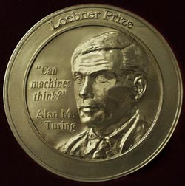

The Turing Test
Alan Turing: “Can Machines Think?”
Interrogator
Written Communication
Human Being
Computer
Loebner prize established in 1990

Slide 18
Areas of AI 2010’s & 2020’s
Natural Languages,
Expert Systems,
Cognition and Learning,
Computer Vision and
Automatic Deduction
Deep Learning
RPA / IPA

Slide 19
The future?
Metaverse and singularity

Slide 20
What happens when video games meet Web 2.0?
When virtual worlds meet geospatial maps of the planet?
When simulations get real and life and business go virtual?
When you use a virtual Earth to navigate the physical Earth, and your avatar becomes your online agent?
What happens is the metaverse.

Slide 21
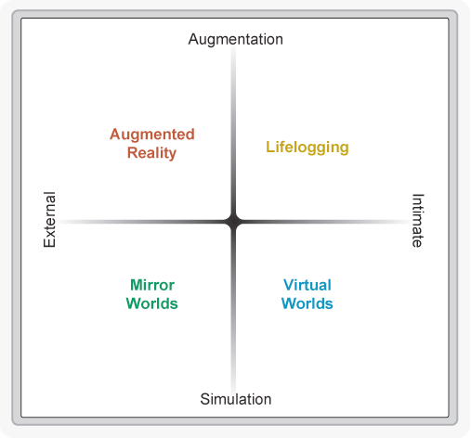

Slide 22
The Second Machine Age

Slide 23
“Information is costly to produce but cheap to reproduce.
Shapiro and Varian
Instantaneous online translation services, one of the science-fiction-into-reality technologies
They make use of paired sets of documents that were translated, often at considerable expense, by a human from one language into another. For example, the European Union and its predecessor bodies have since 1957 issued all official documents in all the main languages of its member countries, and the United Nations has been similarly prolific in writing texts in all six of its official languages.

Slide 24
Translation
This huge body of information was not cheap to generate, but once it’s digitized it’s very cheap to replicate, chop up, and share widely and repeatedly. This is exactly what a service like Google Translate does. When it gets an English sentence and a request for its German equivalent, it essentially scans all the documents it knows about in both English and German, looking for a close match (or a few fragments that add up to a close match), then returns the corresponding German text.
Today’s most advanced automatic translation services, then, are not the result of any recent insight about how to teach computers all the rules of human languages and how to apply them. Instead, they’re applications that do statistical pattern matching over huge pools of digital content that was costly to produce, but cheap to reproduce.
Similar work was produced using Canadian Parliament reports in English and French

Slide 25
What Happens When the Content Comes Freely?
But what would happen to the digital world if information were no longer costly to produce? What would happen if it were free right from the start? We’ve been learning the answers to these questions in the years since Information Rules came out, and they’re highly encouraging.
The old business saying is that “time is money,” but what’s amazing about the modern Internet is how many people are willing to devote their time to producing online content without seeking any money in return.
WHY?
Wikipedia’s content, for example, is generated for free by volunteers all around the world. It’s by far the world’s largest and most consulted reference work, but no one gets paid to write or edit its articles. The same is true for countless websites, blogs, discussion boards, forums, and other sources of online information. Their creators expect no direct monetary reward and offer the information free of charge.

Slide 26
1. we’re living in a time of astonishing progress with digital technologies— and networks at their core
These technologies are not brand-new; businesses have been buying computers for more than half a century
it’s taken time to refine our digital engines
Computers are going to continue to improve and to do new and unprecedented things.
key building blocks are already in place for digital technologies to be as important and transformational to society and the economy as the steam engine.

Slide 27
2. the transformations brought about by digital technology will be profoundly beneficial ones.
We’re heading into an era that won’t just be different; it will be better, because we’ll be able to increase both the variety and the volume of our consumption.
We consume information from books and friends, entertainment from superstars and amateurs, expertise from teachers and doctors, and countless other things that are not made of atoms.
Technology can bring us more choice and even freedom. When these things are digitized— when they’re converted into bits that can be stored on a computer and sent over a network— they acquire some weird and wonderful properties.
They’re subject to different economics, where abundance is the norm rather than scarcity. As we’ll show, digital goods are not like physical ones, and these differences matter.
Digitization is improving the physical world, and these improvements are only going to become more important.

Slide 28
3. digitization is going to bring with it some thorny challenges
This in itself should not be too surprising or alarming; even the most beneficial developments have unpleasant consequences that must be managed.
The Industrial Revolution was accompanied by soot-filled London skies and horrific exploitation of child labor. What will be their modern equivalents?
Rapid and accelerating digitization is likely to bring economic rather than environmental disruption, stemming from the fact that as computers get more powerful, companies have less need for some kinds of workers.
Technological progress is going to leave behind some people, perhaps even a lot of people, as it races ahead
there’s never been a better time to be a worker with special skills or the right education, because these people can use technology to create and capture value.
there’s never been a worse time to be a worker with only ‘ordinary’ skills and abilities to offer, because computers, robots, and other digital technologies are acquiring these skills and abilities at an extraordinary rate.

Slide 29
Social Solutions
Over time, the people of England and other countries concluded that some aspects of the Industrial Revolution were unacceptable and took steps to end them (democratic government and technological progress both helped with this).
Child labor no longer exists in the UK, and London air contains less smoke and sulfur dioxide now than at any time since at least the late 1500s.
The challenges of the digital revolution can also be met
It’s important to discuss the likely negative consequences of the second machine age and start a dialogue about how to mitigate them

Slide 30
Thinking Machines, Available Now
Machines that can complete cognitive tasks are even more important than machines that can accomplish physical ones.
digital machines have escaped their narrow confines and started to demonstrate broad abilities in pattern recognition, complex communication, and other domains that used to be exclusively human

Slide 31
recently seen great progress in
  natural language processing,
  machine learning (the ability of a computer to automatically refine its methods and improve its results as it gets more data), computer vision,
  simultaneous localization and mapping, a
  areas ranging from trivial to substantive to life changing. T
  trivial uses of AI include recognizing our friends’ faces in photos and recommending products.
  substantive ones include automatically driving cars on the road, guiding robots in warehouses, and better matching jobs and job seekers.

Slide 32
Outstanding features of the second machine age
sustained exponential improvement in most aspects of computing
extraordinarily large amounts of digitized information
recombinant innovation.

Slide 33
Reference
Brynjolfsson, Erik; McAfee, Andrew (2014-01-20). The Second Machine Age: Work, Progress, and Prosperity in a Time of Brilliant Technologies (pp. 62-64). W. W. Norton & Company. Kindle Edition.

Slide 34


Slide 35


Slide 36
Big Data Based Government Economic Monitoring and Targeted Action (GEM)
Arion Cheong
Miklos A. Vasarhelyi
Xin Xin Wang
KPMG Distinguished Professor of Accounting Information Systems and Director of Rutgers Accounting Research Center and Continuous Auditing & Reporting Lab (CAR Lab)

Slide 37
GEM Overview
The US Government 6 major social welfare programs (Temporary Assistance for Needy Families program, Medicaid, Child's Health Insurance Program, Food Stamps, Supplemental Security Program, Earned Income Tax Credit, and Housing Assistant program)
Using modern information technology to directly guide government provide target actions.
Big Data based GEM will enable the close-to-timely-reality tracking of microeconomic status in real-time.
Surveillance capitalism VS Your Big HUG government

Slide 38

Big Data Collection
Police Report
Government Agency
Online Retailers
Supermarkets
Drug Usage
Transportations
Stock Market
Telephone
Energy Usage
Darkweb

Slide 39
Data Tree

Slide 40
Pattern Identification
Pattern Identification
Traditional
Supervised Data Learning
Field Case Identification
Privacy-preserved Blockchain Database
Unique Identification

Slide 41
Compare with
Prescriptive
Model
Individual/Family Index
Community Profile
Create
Pathology
Index
Social Aggregated Index
Pathology
Pattern
Model
Connection

Slide 42

Government Blockchain
Governmental Institutions Blockchain
A wants to vote
15%
B need to fill her tax return
C is a senior citizen who needs to receive social welfare payment

Slide 43
Family/Individual Index

Slide 44
Needs - Assistant Mapping
Hunger
Child Care
A
Drug Abuse
B
D
C
City of Newark ( Zip Code Map)
Geographic Identification to neighborhood (Zip code Unit)
Criminal

Slide 45
Alert Dashboard
Alert
Waiting List
Normal
Normal
Normal
Normal
Waiting List
Alert

Slide 46
Privacy-preserved Blockchain Database (CARLab BlockDB)
Privacy Data
BlockDB
by
CARLab
Untraceable
/ Secured Form
Every Privacy data are securely stored in a Blockchain Database BlockDB
BlockDB preserves privacy by transforming all the data in an untraceable format
  Name, SSN, etc. all be replaced to an index where outsiders would never be able to trace back to individuals
  Blocks (data) are only retrievable for analysis

Slide 47
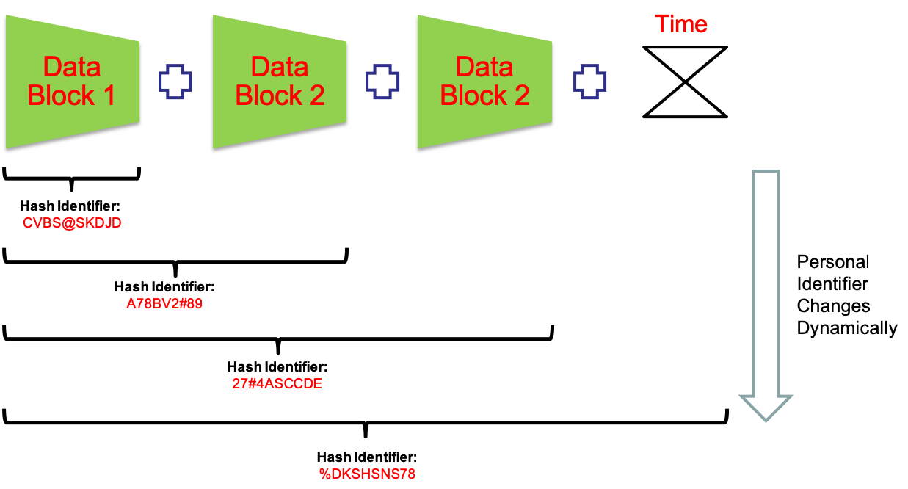
Modules of BlockDB
Untraceable Personal Identifier
(UPI)
  - When any data is added in to the blockchain, BlockDB generates a new hash value which is the new “Personal Identifier”. This personal identifier updates every millisecond which makes the identifier to be untraceable for any outsiders.

Slide 48
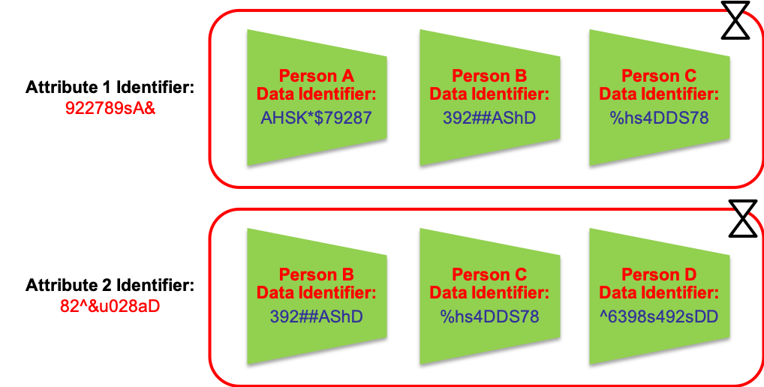
Modules of BlockDB
Data Protection
  Every data input into the BlockDB gets assigned to an index as followed:
  Data attribute identifier + UPI
  As similar to UPI, data attribute identifier dynamically updates every millisecond which makes the data as well as the index to be untraceable

Slide 49


It will look like this:
Even if you obtain
part of the GEM data,
What you get will
look like,
And,
this meaningful information
will change every millisecond.
9A78X%SX*72ZQ”S

Slide 50

Government Action
Social Alert
Family/Individual Index
Processed Information
Security and Protect Privacy
Match
Aggregate
Real-Time Data extract

Slide 51
GEM Dynamic Process
Security and Protect Privacy

Slide 52

Visit Our Website
http://raw.rutgers.edu/GEM.html

Slide 53

A conceptual framework of an audit plan cognitive assistant
Qiao Li
Miklos A. Vasarhelyi
Rutgers, the State University of New Jersey

Slide 54
Introduction
What is Audit Plan Brainstorming Session:
Purpose:
Identify risks and discuss how a material misstatement, whether fraudulent or erroneous, could occur (AICPA, 2016, Landis 2008, Hammersley et al. 2010, Beasley and Jenkins 2003)
Common procedure:
Checklist
Open-ended form (Bellovary and Johnstone 2007)
Limitations with Checklist:
Structurally-restrictive tool
  limits new ideas generation & induces biases
Uncollected experience and expertise
No information retrieval or recommendation support
Current computer assisted audit tools and techniques (CAATTs) cannot provide effective decision support for audit planning risk assessment
Notes:
Brainstorming sessions are mandated in two auditing standards, SAS no. 99 (AICPA 2002), Consideration of Fraud in a Financial Statement Audit, and SAS no. 109, Understanding the Entity and Its Environment and Assessing the Risk of Material Misstatement. SAS. 99 requires auditors identify specific fraud risks and SAS 109 requires auditors identify additional causes of potential material misstatement in the financial statement during brainstorming
The most important purpose of brainstorming is to consider fraud risks that may be present and to emphasize the importance of professional skepticism through the entire audit process.
The members of the attendance include the entire audit team, including partner, manger, senior and new staff, and leaded by partner or manager. The most commonly procedure for brainstorming is using a checklist or using an open-ended form, or both (Bellovary and Johnstone 2007). The time spent on the session varies from 15 mins to 2 hours, mainly 30 mins to 1 hour (Bellovary and Johnstone 2007).
They exchange ideas about how and where they think the client’s financial statements may be susceptible to material misstatement due to fraud and how management could perpetrate and conceal fraudulent reporting or misappropriate assets (Beasley and Jenkins 2003). The most commonly procedure for brainstorming is using a checklist or using an open-ended form, or both (Bellovary and Johnstone 2007).
The most commonly procedure for brainstorming is using a checklist or using an open-ended form, or both (Bellovary and Johnstone 2007).
During the initial stages of an audit, the engagement team will meet to update their understanding of the client. Known as a brainstorming meeting, the goal is to discuss the susceptibility of the entity’s financial statements to material misstatement, either as a result of error or fraud. This is an important step in the audit planning and risk assessment process. One of the methods most commonly used by audit firms during this process is a discussion topic checklist, which provides the engagement team with guidance on discussion procedures but not advanced decision support.
During audit planning and risk assessment, a key step is usually to hold a brainstorming meeting (risk assessment and planning discussion). This occurs after all relevant information has been gathered and a basic understanding of the client has been attained. This must include an understanding of the operating business environment and internal controls. This meeting is a precursor to the testing stage. The brainstorming meeting allows the engagement team to identify risks and initiate a free flow of ideas about how a material misstatement, whether fraudulent or erroneous, could occur (AICPA, 2016).
Since the risk assessment and planning discussion plays such an important role, audit firms use methods designed to facilitate this process. One such method is the discussion topic checklist. The engagement team first needs to recall and retrieve information about the client from memory and from pertinent documents. Next, the team evaluates the information in order to make various engagement specific decisions. More powerful tools/methods would be useful in helping auditors make subsequent risk assessment judgments, and should be developed.
Partner: hile audit partners do not engage actively in the daily tasks of working a client’s audit, they work in tandem with their audit team when necessary. Partners generally meet with the client and introduce the audit team prior to the audit engagement. They periodically will check in with their audit team to ensure that deadlines are being met and that no significant issues have occurred during the audit. As the audit draws to a close, partners will review their team’s information and meet with their client in a final exit meeting. Outstanding issues from the audit will be corrected or followed up by the audit partner after the audit is closed out with the client.
Manager: http://www.parkerlynch.com/jobs/job-descriptions/Pages/audit-manager.aspx
In-depth knowledge of GAAP guidelines and Sarbanes-Oxley rules and regulations
Strong background and experience with audit methodologies and techniques
Prior success conducting external or internal audits
Ability to build relationships while asking tough questions
Excellent written and oral communication ability
Strong time management and organizational skills

Slide 55




Proposed Audit Cognitive
Assistant Luca
Open an application
Interface
Luca
Luca
Luca
industry
Client
Processing…
Luca
Recommended Topics:
General understanding, new events, business risks…
Query
Position
You may also interested in:…
Show
Answer
Domain: judgement or experience
Unstructured: financial statements, accounting policies, analytical procedures, litigation, claims, recent news information, audits workpapers, prior year audit deficiencies and adjustments…
User interaction: queries and search
Modules:
Automatic Speech Recognition (ASR)
Language Understanding
Dialogue Management
Natural Language Generation
Text-to-Speech synthesis
App | Capability
1 | Search engine such as google
2 | ACL, IDEA
3 | Ratios; others like Benford’s law
4 | Regulations related to the audit area or account
5 | Required procedures, guidance or programs
6 | Open prior audit
7 | Audit plan schedule
Answer
Architecture
Query Classifier
Automatic Speech Recognition
QA
Question or Action
DBMS
Knowledge Base
text
Action
Execute
Action
Audit Related Applications It Can Access
Knowledge Database
backstage supporter
Web Search
Open (ACL, IDEA…)
Calculator
Domain Knowledge
Unstructured data
Knowledge about users
Open standards
Open templates
Audit work paper
Calendar
…….
Notes:
Replace with visio
Voice command: ASR
Voice query: ASR&QA
Industry and company must be selected in the beginning of the usage for two main reasons: access control and recommender support. First, in an audit engagement case, the engagement team members should only be authorized to access to information sources that relevant to the case, while data about other clients stored in the knowledge based should not be accessible by these auditors. The selection of industry and client name is the control for information access. Second, since data sources in the knowledge base are supposed to be categorized and tagged, the recommender system and question answering system will process faster in preparing answers under selected industry and client. By choosing the position of the user, such as partner, manager, junior auditor, tax expert, IT expert etc., the cognitive assistant will be able to learn and memorize queries and actions performed by auditors with different experiences and expertise through interactions, then provide relevant and customized recommendations to following users that have are in similar positions. For example, if the audit manager is new to the team, when interacting with the tool, he will receive recommended discussion topics that raised by other senior auditors when they assess risk for this client or similar clients in this industry in prior audit.
Auditors can give commands or ask questions to the proposed system by either (1) voice (by clicking the speaker icon in the interface) or (2) typing. Once a question is asked, the cognitive assistant will generate an answer or open an application based on the command.
Similar to humans, cognitive systems have a way of gathering, memorizing and recalling information, which is the equivalent of human memories. Cognitive systems also have a basic ability to communicate and act.
5.1.3 Architecture
The middle layer is the proposed architecture (process) of the audit cognitive assistant. Auditor interact with the tool by talking to it or typing in the question that they want to ask. Auditor’s voice is processed by the Automatic Speech Recognition (ASR), which translates his speech question into its text equivalent through analytical models. The translated text then goes to Query Classifier which decides if the command is an action or a question. If it is an question, then command goes to the QA system. QA system will extract information from the question, search its database, and choose or generate best answer to return to the auditor. If it is an action, then the command is send back to the system to execute the required application.
4.1.4 Backstage Supporter
Applications
Applications means the third-party apps that are linked with the proposed audit cognitive assistant for direct execution. For IPAs such as Apple Siri, users can use it to create query like “open message” or “call ***”, and the related app will be opened. Audit brainstorming meetings are non-stop conversations among a group of people in a short time, and auditors need to refer to various documents to discuss client and make judgments, therefore this function in the cognitive assistant become an “information and task manager” that help improve the work efficiency of auditors during the process and make them focus more on important tasks such as risk discussions. For example , web search allow information that cannot be found in the current knowledge base to be found through existing online search engines. Auditors may be interested to know new information such as economic factors and latest events about a client during the risk assessment, and the best way to access to those information is through general or financial specific online search engines. The System Administrator should track the web searches through this system and organize and incorporate commonly searched terms into the knowledge base.
Knowledge base
The last portion is the knowledge base. Three main information sources - domain knowledge, unstructured data and knowledge about users provide information to support the intelligent decision support functions in the system. The knowledge base stores all relevant data sources that could be used by the engagement team for the risk assessment. Organized knowledge storage free the audit partner and manager from memorizing huge amount of information. It provides efficient information retrieval during brainstorming for question answering and recommendation system.
Text resources are unstructured data sources stored in the knowledge base. Phrases, sentences and paragraphs in all text resources will be tagged based upon pre-determined question category and answer type to enable the information in those texts can be extracted by algorithms during user query. Data sources include financial statements, accounting policies, analytical procedures, litigation, claims, recent news information, audits work papers, prior year audit deficiencies and adjustments, etc.
Domain knowledge means collected experience and expertise from auditors. Some of these knowledges are important facts about client financial situation that could be collected and prepared before discussion. Some knowledge is judgements or experience that were extracted from prior audit documents, which provide important insight for current new cases. These domain knowledges can be prepared and stored in the cognitive assistant as paired questions and answers for queries, and they should be stored as structured data a relational database.
The third type of knowledge is new knowledge gained through user interactions with the IPA. Based on user’s queries and behaviors, related knowledge is collected for future recommendation in similar situations.
In the big data era, the combination of various data sources with integrated analysis can provide powerful support for auditors and managers. This allows them to be better aware of industry environment and related changes, understand company’s performance, and identify areas of risk on which to focus.

Slide 56
Luca Q-A Module
Question Analysis
Knowledge base
Answer Selection
Answer
Question
Normalized Question
Machine Learning Models
Answer with highest score
Keyword extraction;
Punctuations, abbreviations, nouns and verbs
Query Generation
Generated Query
Answer Matching
Doc. With Candidates
Answer Extraction
②
DBMS
①
① +②
IR-based (Domain) QA +
Knowledge-based (Cognitive) QA
Paired QA
NL Answer Generating
Answer
Notes:
If knowledge base: candidate answers are extracted and final answer is selected based on cognitive technologies through understanding and analyzing related documents in knowledge base;
If auditor knowledge: pre-paired Question and Answer extracted from DBMS

Slide 57
Application to other audit phases
Major phases of an audit:
Client acceptance, preliminary engagement activities, audit plan, internal control audit, business processes and accounts audit, audit completion (Messier et al. 2016).
 | Client acceptance | Preliminary engagement activities | Audit plan | Internal control audit | Business processes and accounts audit | Audit completion
Decision support in the cognitive assistant
-Information Retrieval | √ | √ | √ | √ | √ | √
-Recommendations | √ | √ | √ | √ | √ | √
-App connections | √ | √ | √ | √ | √ | √
Collected Knowledge
-NLP conversation analysis framework | √ |  | √ | √ |  | √
Notes:
For each audit phase:
Where to use the proposed cognitive assistant and who are the users?
Where to apply the proposed NLP conversation analysis framework?
How to build important modules?
Knowledge base (QA categories)
Recommendations
Related apps

Slide 58
Application to other audit phases
Application of the proposed tool to: Client Acceptance
Decision Support | Detailed design | Technical support and knowledge sources
Information Retrieval | Question categories | Sub-question categories
 | Management | Management integrity, Management tone toward financial reporting, management competence, turnover of key personnel; | Available files: entity documents and reports Collected knowledge: Documented observations and inquires; converted inquires and meeting discussions
 | Financial health | Financial distress, financial leverage, profitability of company, company cash flow, stock volatility
 | Company characteristics | Complexity of company, business changes, Accounting & Finance Dept personnel competence, internal controls, litigation risk/ prior restatements, significant related party transactions, strain the client puts on the audit firm’s staff, reasons for change of auditors
 | Governance | Audit committee competence, Audit committee financial expertise
 | Auditor characteristics | Availability of appropriate personnel, sufficient expertise of personnel, profitability of engagement
 | Client Continuance | Significant event; conflicts over accounting and auditing issues; disputes over fees
Knowledge type | Details | Format to save in the QA system
Available files | - Financial information: annual reports, interim financial statements, income tax returns, etc. - Regulations, audit standards - Received inquiry from third parties - Notes from meetings discussion - Memo or completed entity acceptance questionnaire or checklist - Documented inquiries from predecessor auditor - Copies of working papers from predecessor auditor - Risk rating from audit programs | IR-based QA system and knowledge QA system
Collected knowledge | - Converted knowledge from conversational teleconference, meetings, inquiries | Knowledge QA system
Recommendation | Sub question categories; Updated related topics discovered from adaptive learning module | Pre-defined recommendation table; Adaptive learning module
Applications | Audit programs/tools | Service Delegation module
Notes:
Decide whether to accept new clients and to retain current clients (Messier et al. 2016, Hsieh & Lin 2015)
Communicate with different parties and consider possible unusual business or audit risks (Messier et al. 2016)
Consider management, financial health, company background, audit risk, litigation risk, expertise of engagement personnel, audit fee etc. when accepting new engagement; Consider significant event and potential conflicts or disputes when making a client continuance (Hollingsworth 2012, Hsieh & Lin 2015).

Slide 59
Thank you!

Slide 60
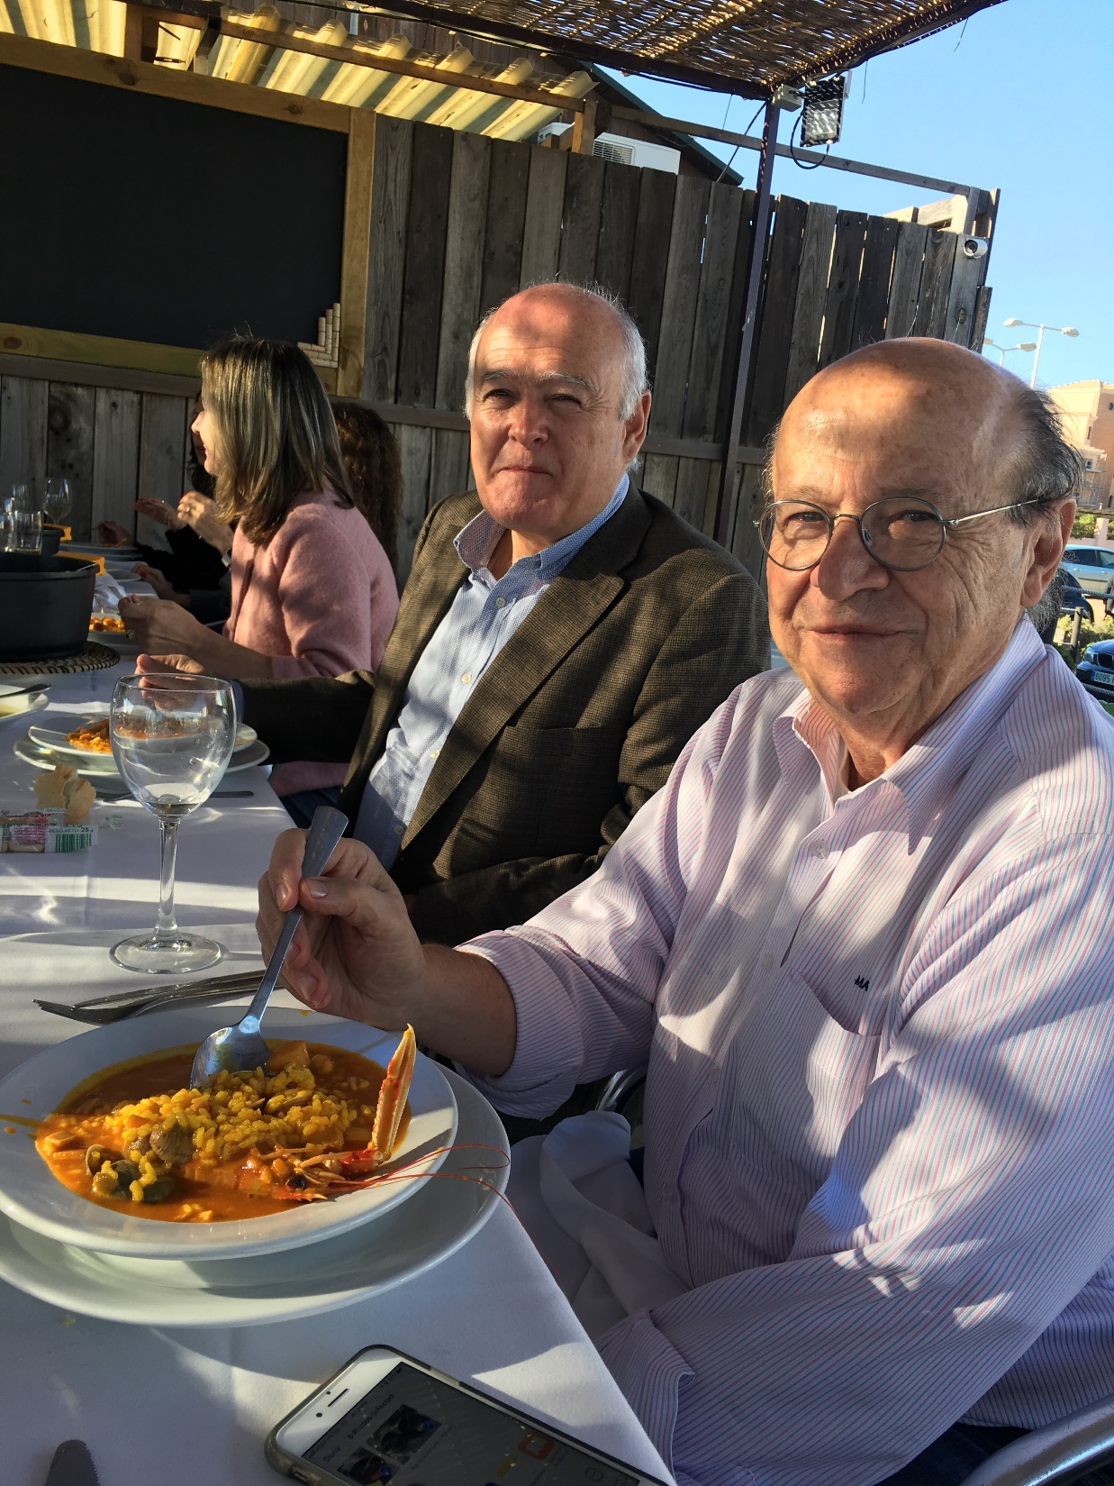

Slide 61


Slide 62


